Slide 1
Spring Boot Development

Slide 2
Contents
Creating an app using Spring Initializr
Work with an IDEA
Implementing Application Functionality
Creating an app using Spring Tool Suite (STS)
Exercise
Demo folder
DemoSpringBootDev

Slide 3
1. Creating an App using Spring Initializr
Overview of Spring Initializr
Creating a web application
Example web application
Pinging the web server

Slide 4
Overview of Spring Initializr
Spring Initializr is a Web service from Pivotal, to help you generate a Spring Boot app
Accessible via https://start.spring.io
Spring Initializr displays a Web page, where you specify details for your Spring Boot app
E.g. Maven dependencies, packaging, etc.
Then click "Generate Project", to generate the app as a zip file
See next slide for an example
Note:
Spring Initializr is what Spring CLI uses under the covers, to generate a Spring Boot app based on command-line options

Slide 5
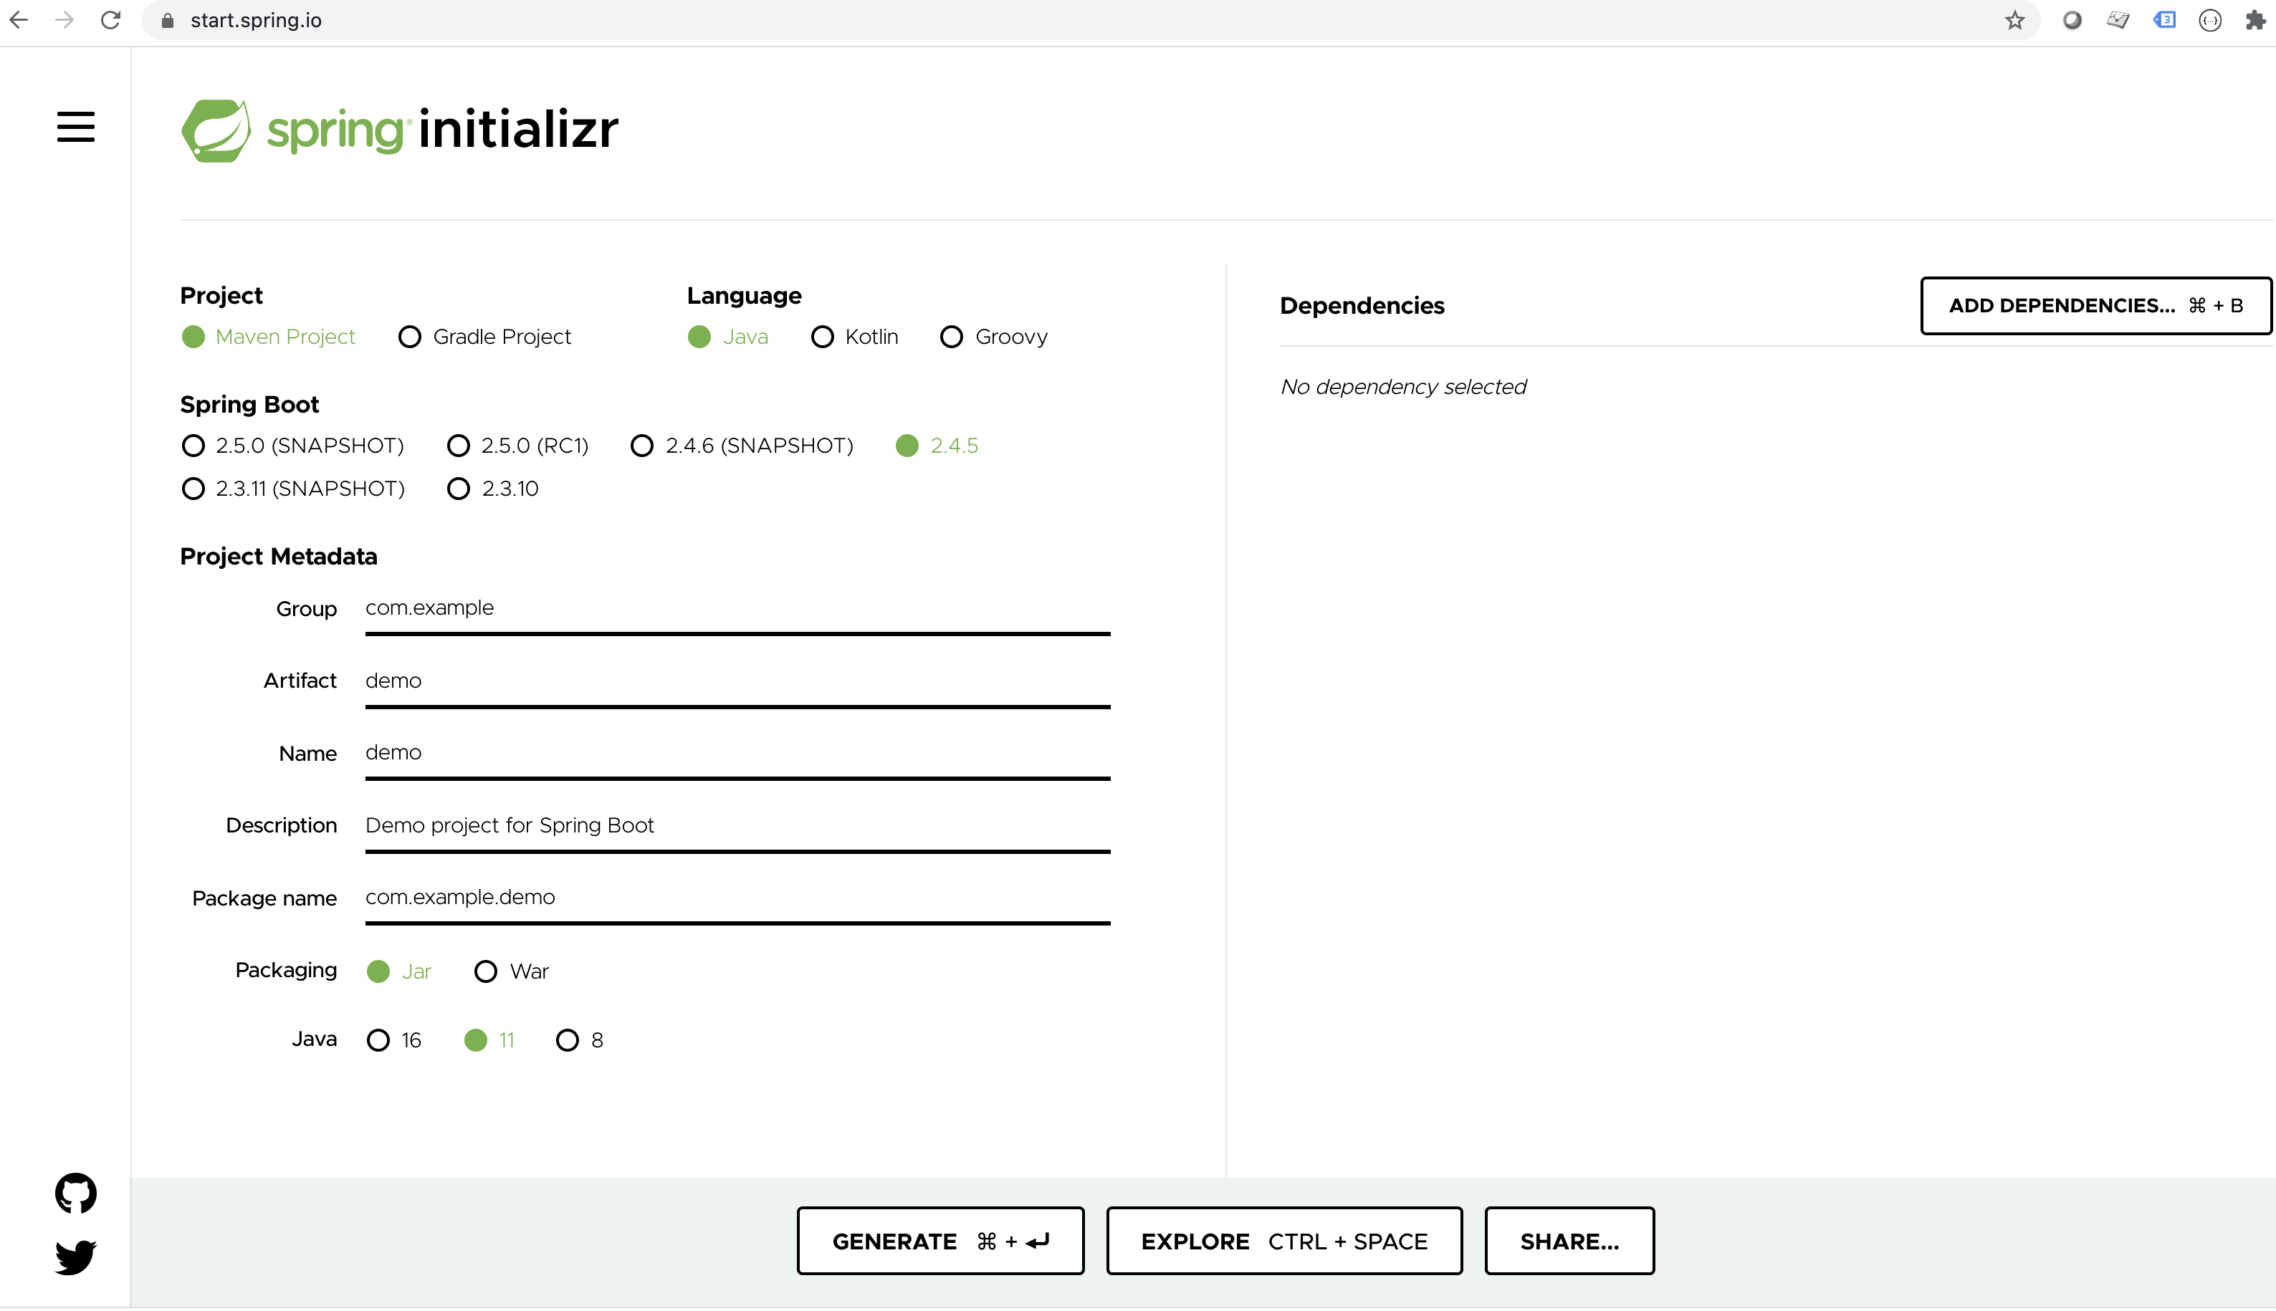
Creating a Web Application (1 of 3)
Here's the simple version of the Spring Initializr web page

Slide 6
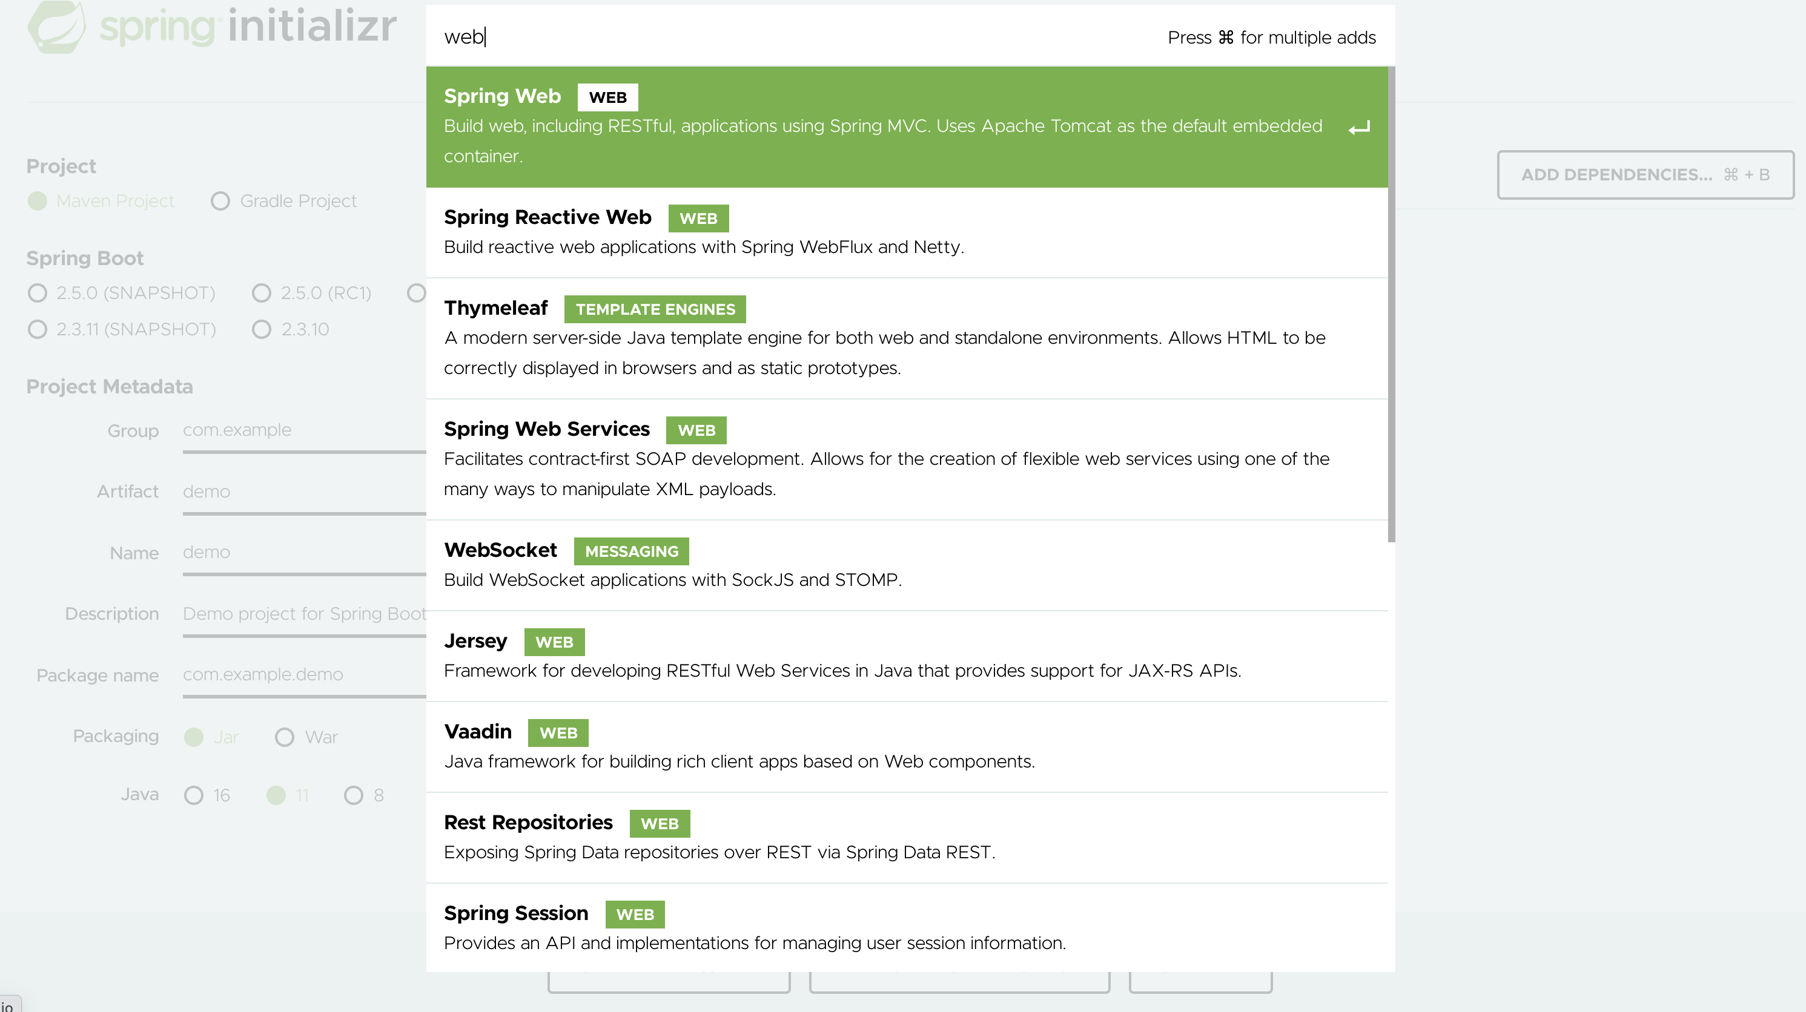
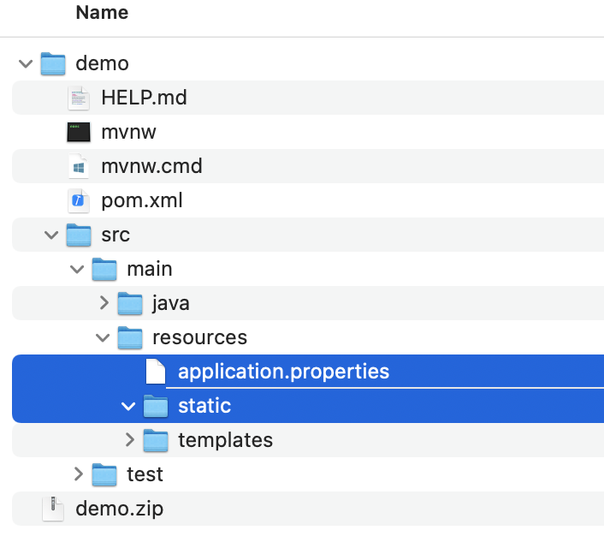
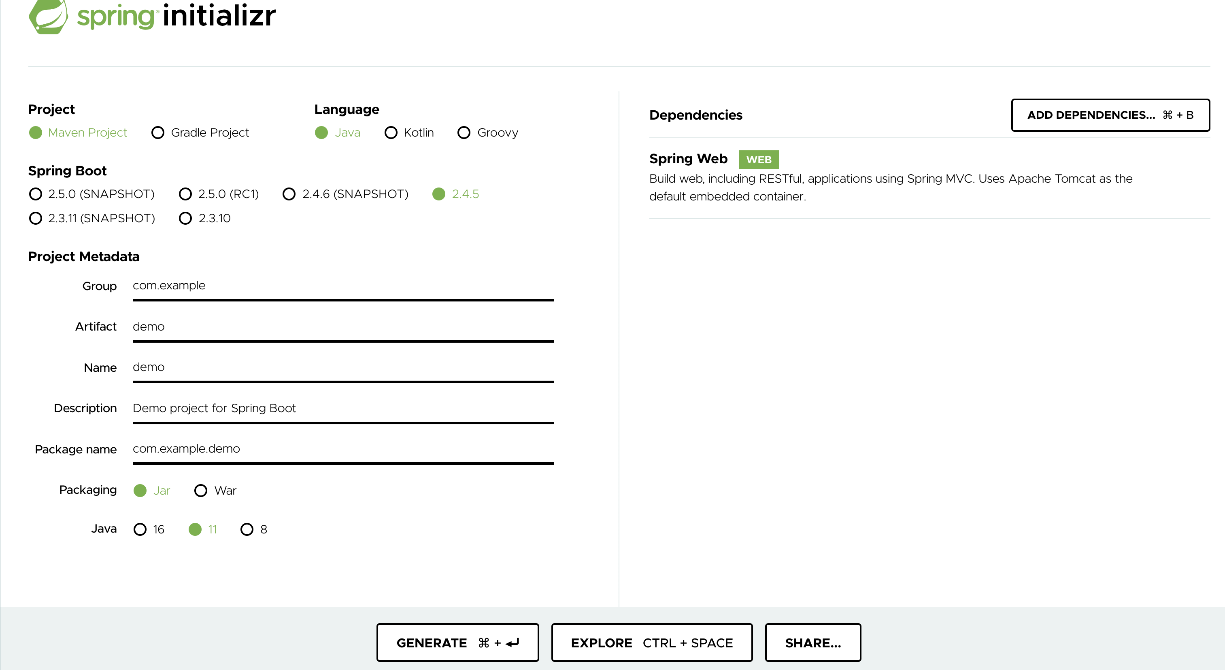
Creating a Web Application(2 of 2)
Choose project specific configuration, Add dependencies, generate project and extract

Slide 7
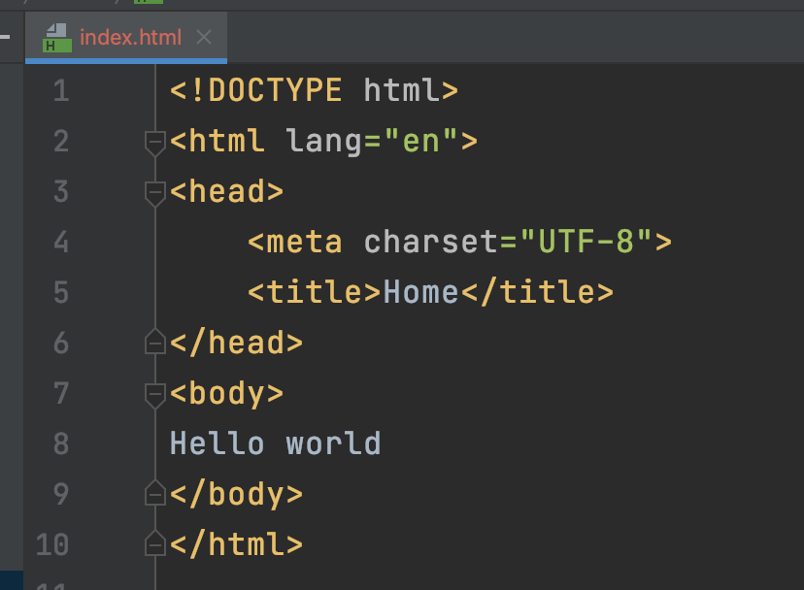
Example Web Application
The application is the same as if you’d used Spring CLI
Same project structure, same code artifacts etc.
You can add a simple index.html
Put it in the resources\static folder
You can specify the server port
Edit src\main\resources\application.properties
Server.port=8081
You can run the app via Maven, as before
mvn spring-boot:run

Slide 8
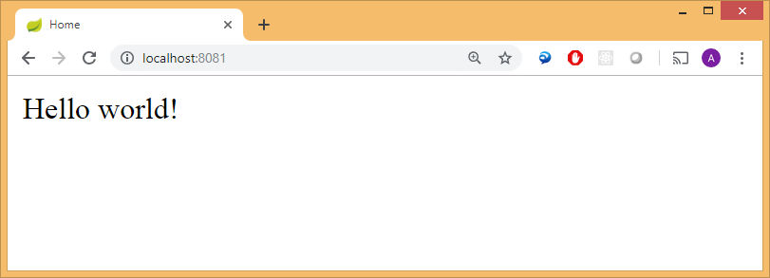
Pinging the Web Server
Open a browser and navigate to http://localhost:8081
Renders index.html, because this is a default filename

Slide 9
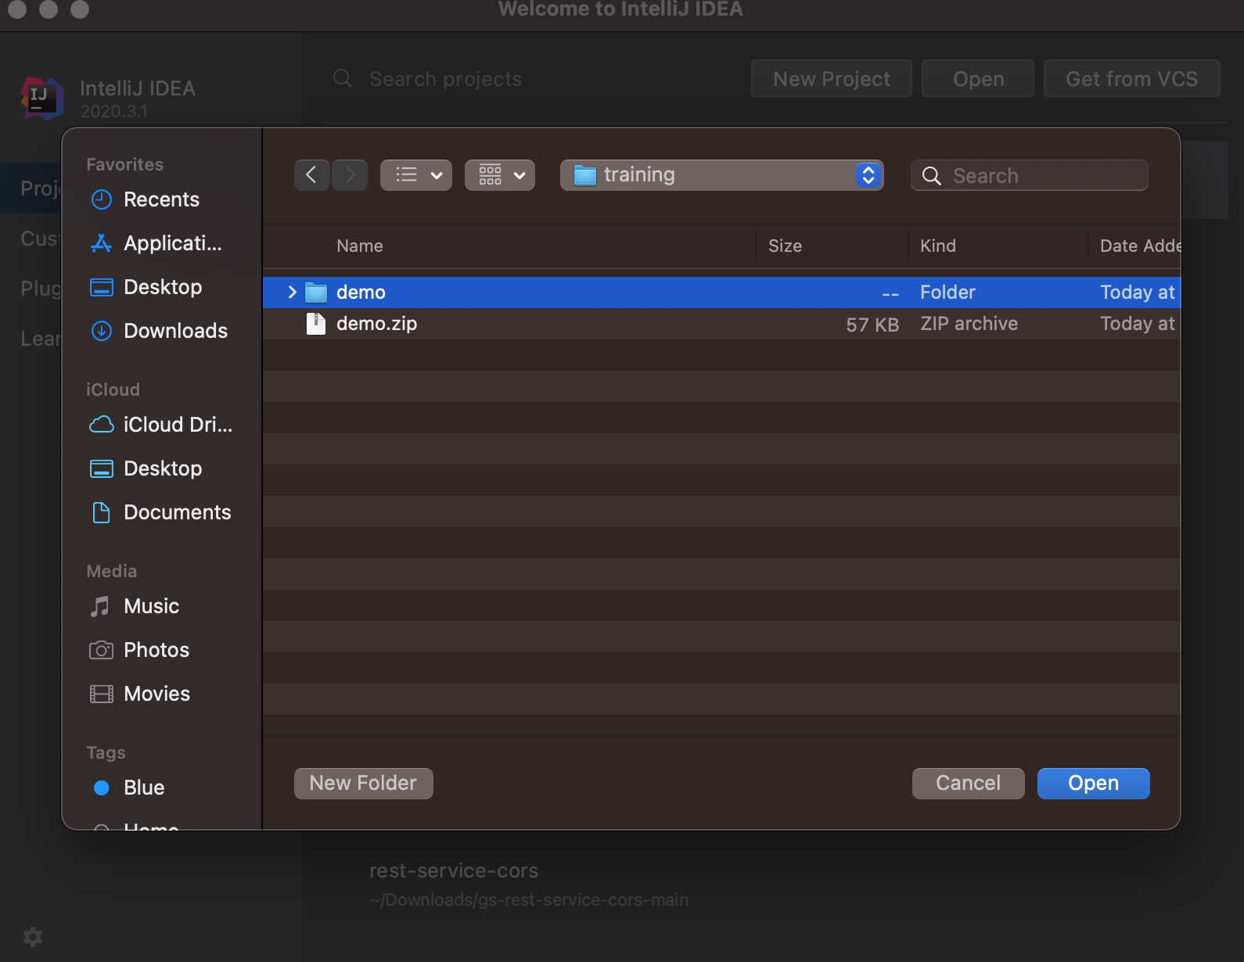
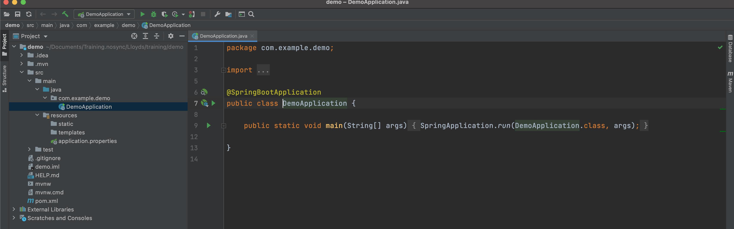
2. Work with an IDEA (IntelliJ IDEA)
Open the downloaded project in IntelliJ IDEA

Slide 10
3. Implementing Application Functionality
Editing application properties
Restarting the application
Implementing a RESTful Web service
Testing the RESTful Web Service
Notes:
In this section we're going to add some functionality to our fledgling Spring Boot web application.

Slide 11
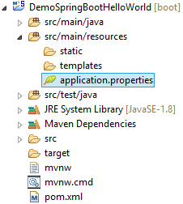
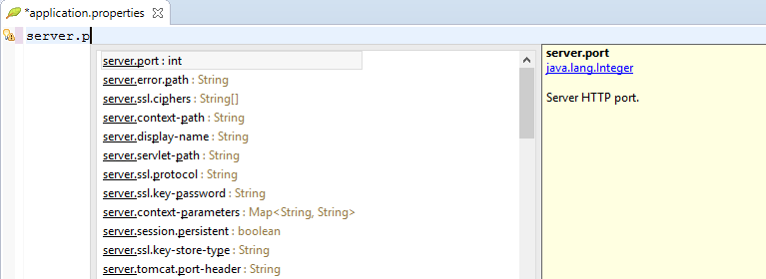
Editing Application Properties
You can edit application properties
server.port=8081
Notes:
Spring Boot applications have an application.properties file, where you can set properties for your application. To help you edit application.properties, STS provides a Spring Properties Editor tool. The editor provides nice content assist and error checking, as shown in the slide.
In the slide, we've set the server.port property to a different port number (e.g. 8888) rather than the default value (8081).

Slide 12
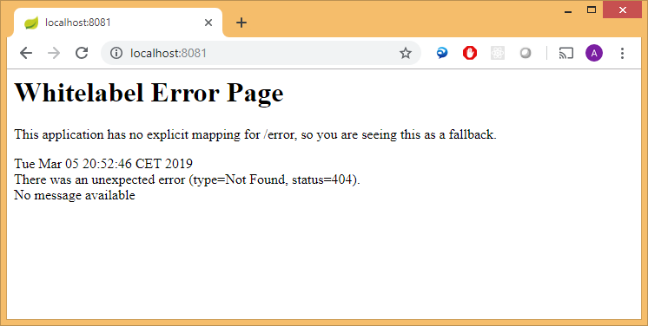
Restarting the Application
Restart the application, and verify Tomcat starts on the new port number, 8081
Ping the Web server using the new port number, 8081
Notes:
To verify the application property has taken effect, stop and restart the application (use the following button in the STS toolbar):
The console window should display messages indicating Tomcat has restarted on the new port, and you should be able to browse to the new URL, e.g. http://localhost:8081. See the screenshots in the slide.

Slide 13
Implementing a RESTful Web Service
It's simple to implement a RESTful Web service!
Define a class and annotate with @RestController
Add methods and annotate with @RequestMapping
package demo.springboot.helloworld;
import org.springframework.web.bind.annotation.RequestMapping;
import org.springframework.web.bind.annotation.RequestParam;
import org.springframework.web.bind.annotation.RestController;
@RestController
public class HelloController {
@RequestMapping("/hello")
public String hello(@RequestParam String name) {
return "Hello " + name;
}
}
Notes:
Spring Boot greatly simplifies many common tasks. For example, the code shown in the slide is a fully functional RESTful Web service in Spring Boot.

Slide 14
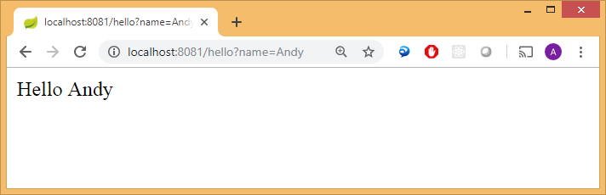
Testing the RESTful Web Service
Restart the application and browse to a URL such as:
http://localhost:8081/hello?name=Andy
Notes:
This slide shows that the RESTful service is up and running!

Slide 15
4. Creating an App using STS
Overview of Spring Tool Suite
Creating a Spring Boot project
Example web application

Slide 16
Overview of Spring Tool Suite
Spring Tool Suite (STS) is an Eclipse-based IDE, with the Spring plugin installed
You can download STS for free from https://spring.io/tools/sts/all
Provides wizards/menus to simplify Spring development
E.g. create Spring Boot apps (via Spring Initializr implicitly)
E.g. create Spring Framework apps (it calls them "legacy projects")
Note:
All contemporary Java IDEs include Spring Boot support
E.g. IntelliJ (Ultimate edition only), NetBeans, etc.

Slide 17
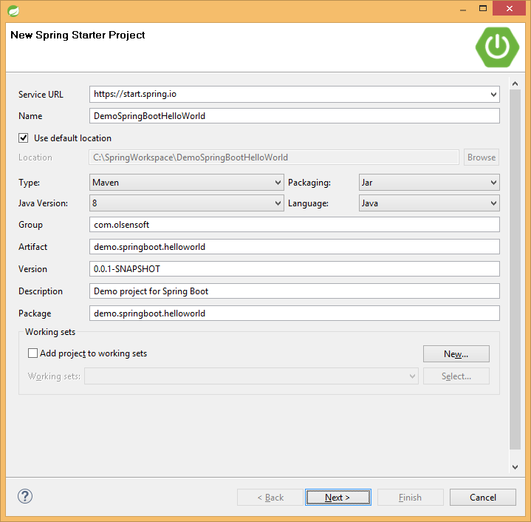
Creating a Spring Boot Project (1 of 3)
In STS, select File | New | Spring Starter Project
Notes:
On the next few slides, we show how to create a Spring Boot project using the Spring Tool Suite.
To get started, invoke the menu command File | New | Spring Starter Project. The dialog box shown in the slide appears. Specify details such as the following:
Name: DemoSpringBootHelloWorld
Type: Maven (or Gradle if you prefer)
Packaging: Jar (even if you want to create a web application!)
Java version: 1.8
Language: Java
Group: An appropriate domain name
Artifact: An appropriate artifact ID, e.g. the same as the project name
Package: An appropriate package name
Then click Next.

Slide 18
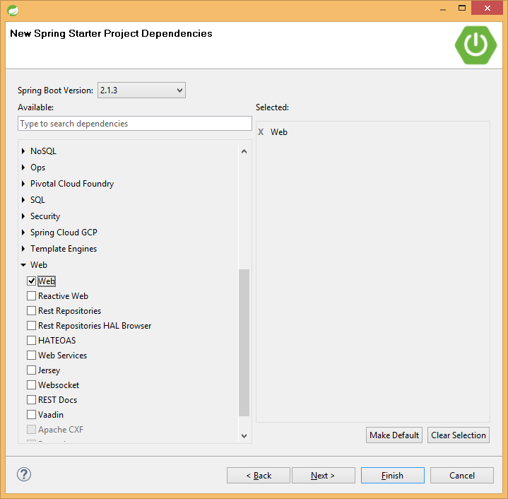
Creating a Spring Boot Project (2 of 3)
Select one of the quick-starts, e.g. Web
Notes:
We're going to create a Web application in our walkthrough, so select the Web option from the list of available quickstarts. Then click Next.

Slide 19
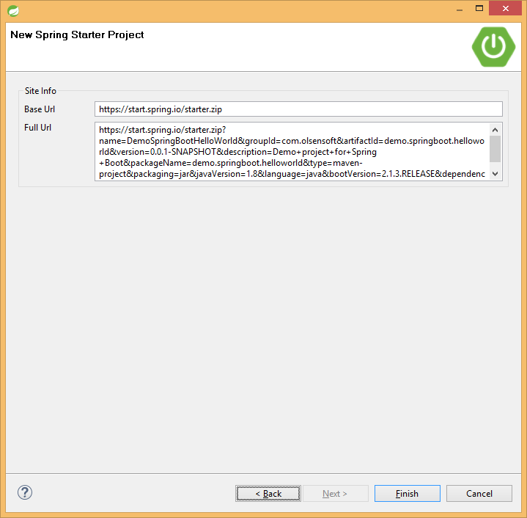
Creating a Spring Boot Project (3 of 3)
Click Finish, to generate your project
Notes:
When you reach the final dialog box, click Finish. The wizard is a GUI frontend - under the covers, it uses the web service at http://start.spring.io/ to generate some basic scaffolding. You could use the web service directly yourself, download the zip it generates, unpack it, import it etc. Using the STS wizard does all of this at the click of a button and ensures the project is configured correctly, so you can immediately start coding.

Slide 20
Reviewing the Generated Application Code
Here's the main code in the application
package demo.springboot.helloworld;
import org.springframework.boot.SpringApplication;
import org.springframework.boot.autoconfigure.SpringBootApplication;
@SpringBootApplication
public class DemoSpringBootHelloWorldApplication {
public static void main(String[] args) {
SpringApplication.run(DemoSpringBootHelloWorldApplication.class, args);
}
}
Notes:
After you've created the project, the only code generated is the Java code shown above. Thanks to the magic of Spring Boot, this minimal amount of code is already a fully functional web server! It doesn’t have any real content yet, of course, but it's still runnable in its current state. See the next slide for how to run the application.

Slide 21
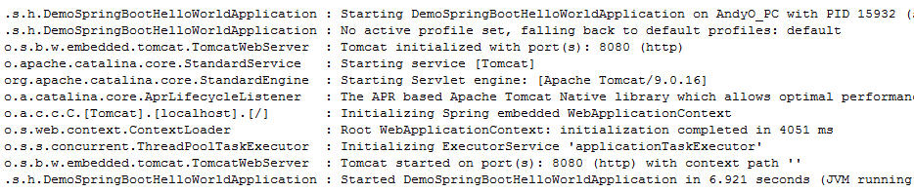
Running the Application
You can run the application as a regular Java application, as normal
Automatically runs Tomcat within the JVM
Notes:
Spring Boot applications created by the wizard come in two flavours: jar or war (you saw this in the Starter wizard just now - it lets you choose to package your application as a jar or war).
What we've done is to create a standalone jar-packaged project that contains a fully functional embedded web server. All you need to do to run your application is to run the application's 'main' type, just like you do any other plain Java application.
This is great - you don’t have to fuss about setting up local or remote Tomcat servers, packaging your application as a war, and deploying it to the web server (if you really do want to do all this, you can easily convert your jar application into a war application at any time).
To run the application via STS, click on the Java main class and select Run As | Spring Boot App (this is a dedicated STS launcher). The app should start and you should see some output in the console view, indicating Tomcat has started on port 8080 - see the screenshots in the slide.

Slide 22
Any Questions?

Slide 23

Exercise
Use STS to create a Spring Boot web app
Add some static content
E.g. the "breakout" content (see previous lab)
Build/run the app and verify you can browse to the static content in a browser
Add a simple REST controller
E.g. to return the current date/time
Build/run the app and verify you can consume the REST service in a browser
Experiment setting various properties in the application.properties file

